Slide 1


for AI prediction
Presented by Mostafa Ayman, Seif Ahmed, Abdallah Hossam

Slide 2
5
4
AGENDA
3
2
1

Slide 3
5
1
4
AGENDA
3
2
1
Introduction

Slide 4
5
10
4
AGENDA
3
2
1
History

Slide 5
5
11
4
AGENDA
3
2
1
Dataset Attributes

Slide 6
5
100
4
AGENDA
3
2
1
CSV DATA ANALYSIS

Slide 7
101
5
4
AGENDA
3
2
1
IMAGE PROCESSING

Slide 8

Introduction
What is AIRBNB ?
How does AIRBNB work?

Slide 9


HISTORY

Slide 10
Dataset attributes
id | NAME | host id | host_identity_verified | host name | neighbourhood group | neighbourhood | lat | long | country | country code | instant_bookable
1001254 | Clean & quiet apt home by the park | 80014485718 | unconfirmed | Madaline | Brooklyn | Kensington | 40.65 | -73.97 | United States | US | FALSE
1002102 | Skylit Midtown Castle | 52335172823 | verified | Jenna | Manhattan | Midtown | 40.75 | -73.98 | United States | US | FALSE
1002403 | THE VILLAGE OF HARLEM....NEW YORK ! | 78829239556 |  | Elise | Manhattan | Harlem | 40.81 | -73.94 | United States | US | TRUE
1002755 |  | 85098326012 | unconfirmed | Garry | Brooklyn | Clinton Hill | 40.69 | -73.96 | United States | US | TRUE
1003689 | Entire Apt: Spacious Studio/Loft by central park | 92037596077 | verified | Lyndon | Manhattan | East Harlem | 40.8 | -73.94 | United States | US | FALSE
1004098 | Large Cozy 1 BR Apartment In Midtown East | 45498551794 | verified | Michelle | Manhattan | Murray Hill | 40.75 | -73.98 | United States | US | TRUE
1004650 | BlissArtsSpace! | 61300605564 |  | Alberta | Brooklyn | Bedford-Stuyvesant | 40.69 | -73.96 | United States | US | FALSE
1005202 | BlissArtsSpace! | 90821839709 | unconfirmed | Emma | Brooklyn | Bedford-Stuyvesant | 40.69 | -73.96 | United States | US | FALSE
1005754 | Large Furnished Room Near B'way | 79384379533 | verified | Evelyn | Manhattan | Hell's Kitchen | 40.76 | -73.98 | United States | US | TRUE
1006307 | Cozy Clean Guest Room - Family Apt | 75527839483 | unconfirmed | Carl | Manhattan | Upper West Side | 40.8 | -73.97 | United States | US | FALSE
1006859 | Cute & Cozy Lower East Side 1 bdrm | 1280143094 | verified | Miranda | Manhattan | Chinatown | 40.71 | -73.99 | United States | US | FALSE
1007411 | Beautiful 1br on Upper West Side | 18824631834 | verified | Alan | Manhattan | Upper West Side | 40.8 | -73.97 | United States | US | TRUE
1007964 | Central Manhattan/near Broadway | 88136055909 | verified |  | Manhattan | Hell's Kitchen | 40.76 | -73.99 | United States | US | FALSE
1008516 | Lovely Room 1, Garden, Best Area, Legal rental | 26802410424 | verified | Darcy | brookln | South Slope | 40.67 | -73.99 | United States | US | TRUE
1009068 | Wonderful Guest Bedroom in Manhattan for SINGLES | 88920244552 | verified | Leonardo | Manhattan | Upper West Side | 40.8 | -73.96 | United States | US | FALSE
1009621 | West Village Nest - Superhost | 46551725984 | verified | Daniel | Manhattan | West Village | 40.74 | -74.01 | United States | US | TRUE
1010173 | Only 2 stops to Manhattan studio | 62566345680 | unconfirmed | Heather | Brooklyn | Williamsburg | 40.71 | -73.95 | United States
1010725 | Perfect for Your Parents + Garden | 80380130347 | verified | Ryan | Brooklyn | Fort Greene | 40.69 | -73.97 | United States
How many instances?
What are the main features?
What is the target?

Slide 11





CSV DATA ANALYSIS
DATA ANALYSIS
DATA MODELING
DATA PREDICTION
IMAGE PROCESSING
IMAGE CLASSIFICATION
IMAGE PREDICTION

Slide 12
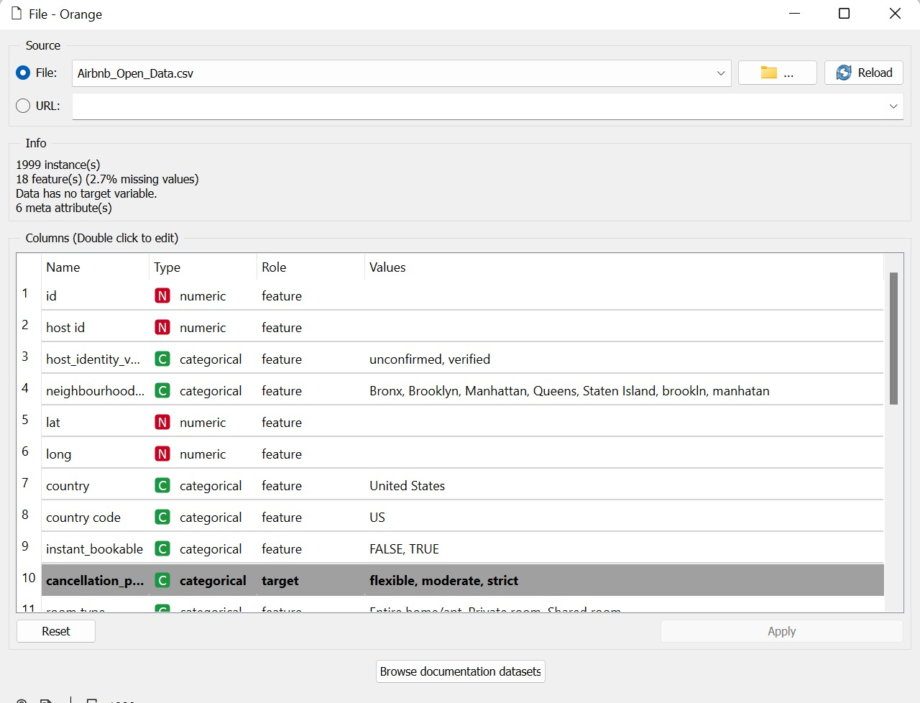

CSV DATA ANALYSIS
DATA ANALYSIS
FILE WIDGET :

Slide 13
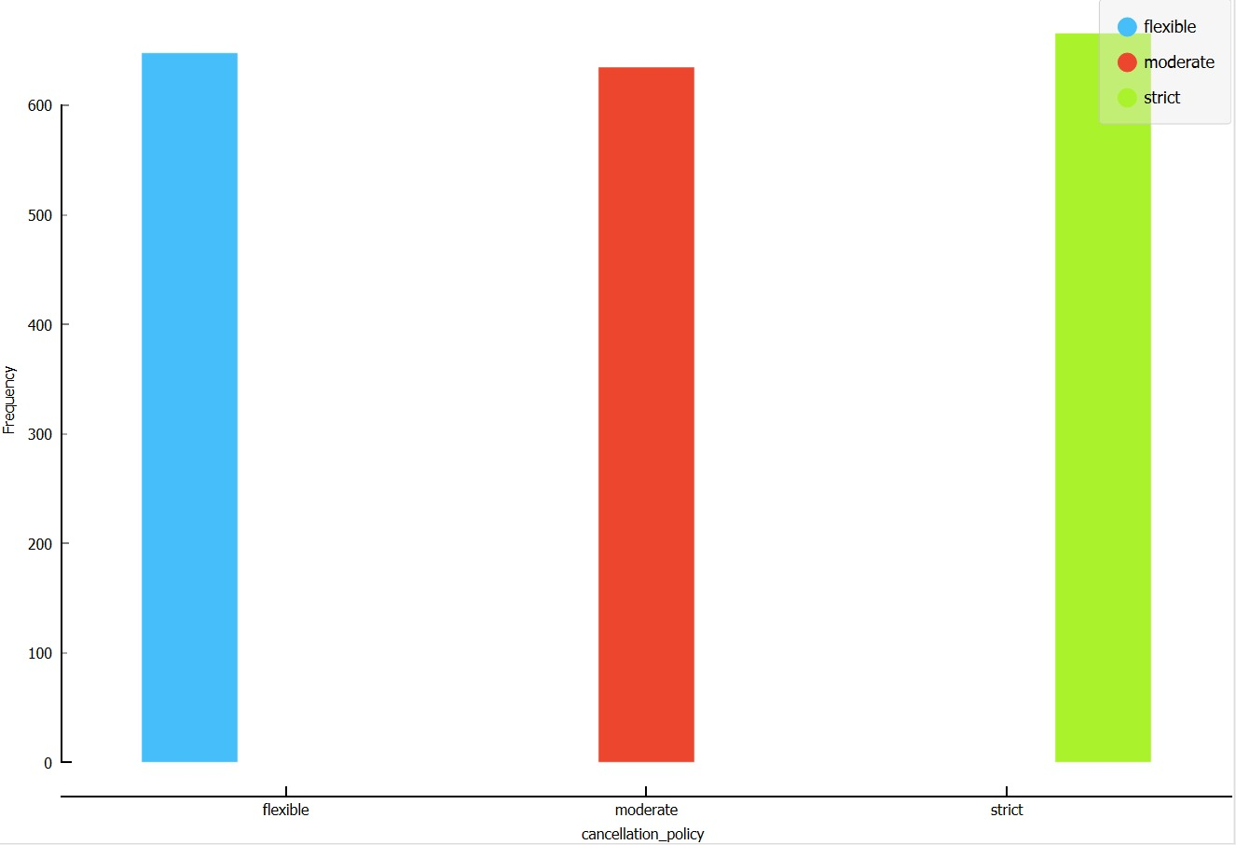

CSV DATA ANALYSIS
DATA ANALYSIS
DISTRIBUTION WIDGET :

Slide 14
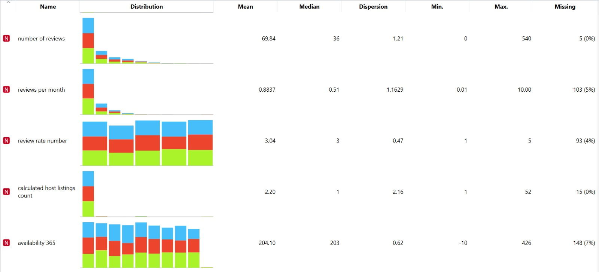
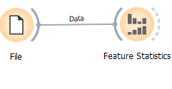
CSV DATA ANALYSIS
DATA ANALYSIS
FEATURE STATISTICS WIDGET :

Slide 15
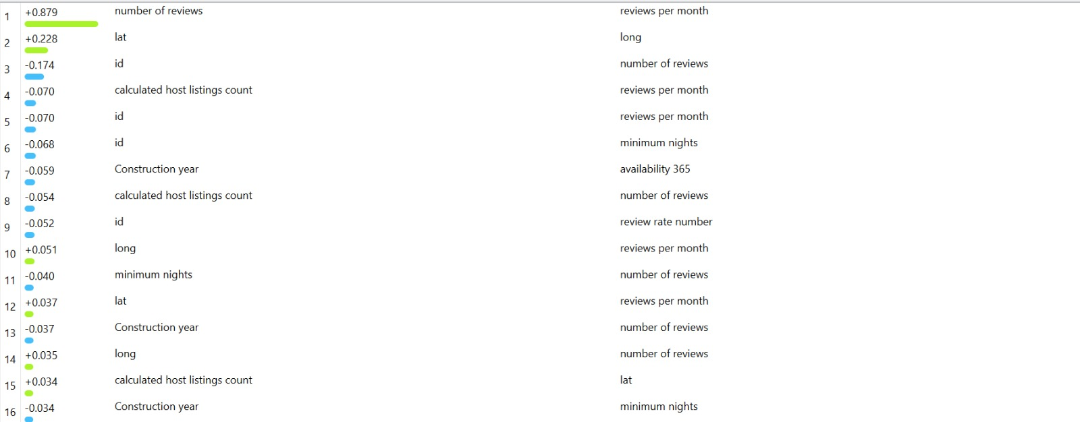
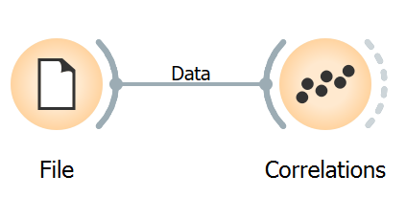
CSV DATA ANALYSIS
DATA ANALYSIS
CORRELATIONS WIDGET :

Slide 16
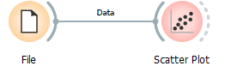

CSV DATA ANALYSIS
DATA ANALYSIS
SCATTER PLOT WIDGET :
FREEVIZ WIDGET :

Slide 17
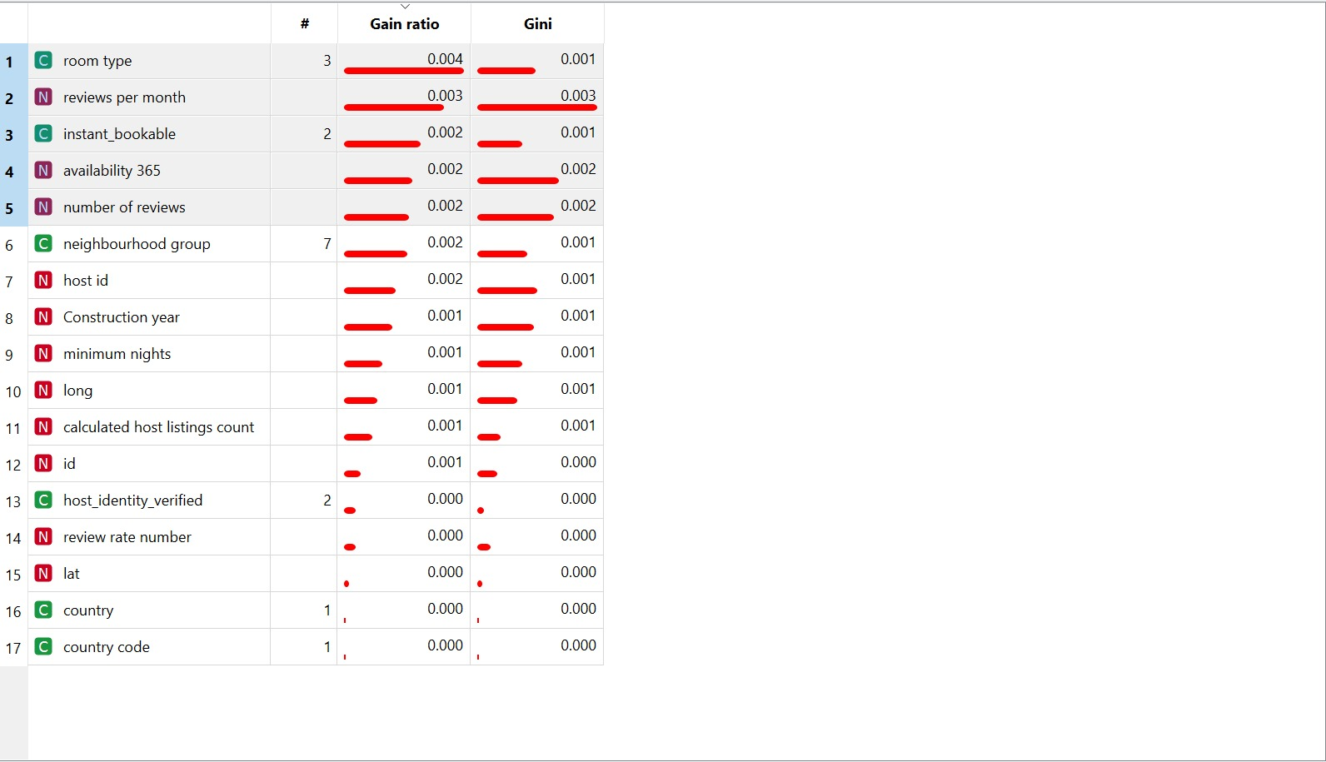
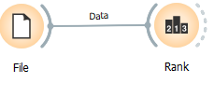
CSV DATA ANALYSIS
DATA ANALYSIS
RANK WIDGET :

Slide 18
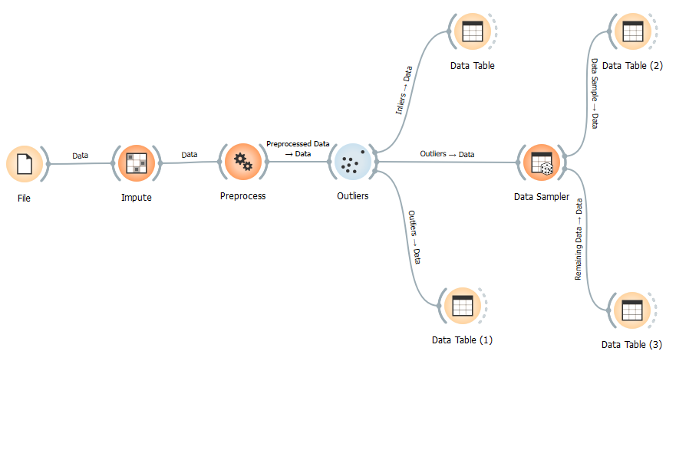
CSV DATA ANALYSIS
DATA MODELING

Slide 19
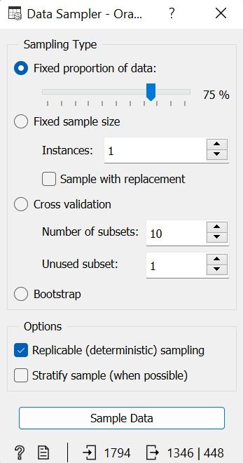
CSV DATA ANALYSIS
DATA MODELING
DATA SAMPLER WIDGET :

Slide 20
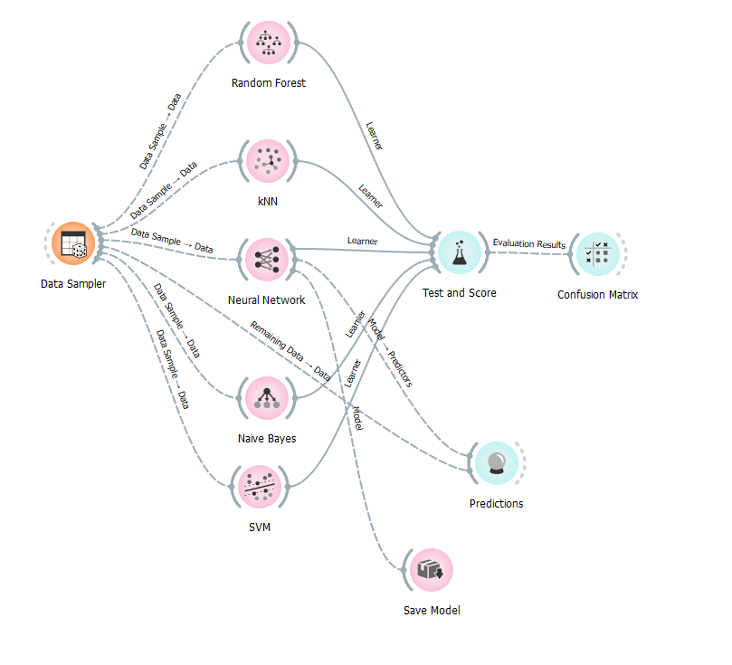
CSV DATA ANALYSIS
DATA MODELING

Slide 21
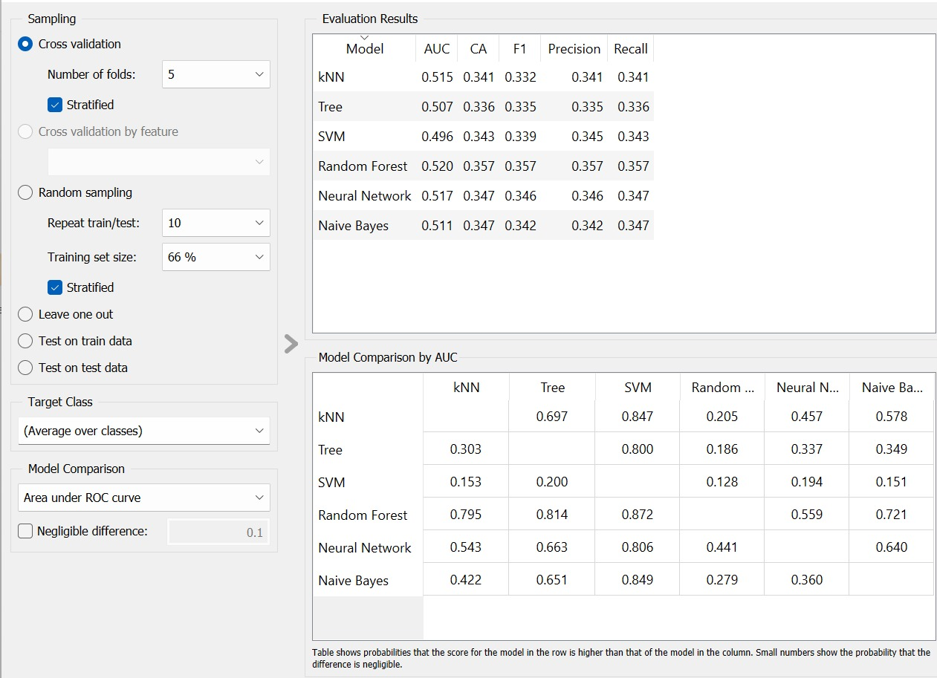
CSV DATA ANALYSIS
DATA MODELING
TEST AND SCORE WIDGET :

Slide 22
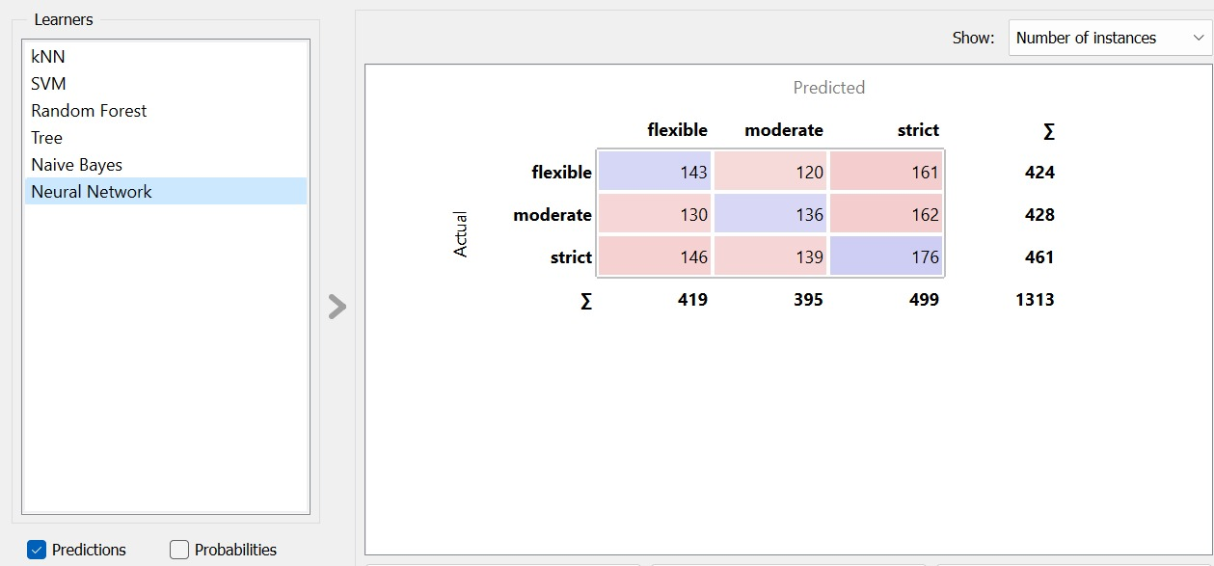
CSV DATA ANALYSIS
DATA MODELING
CONFUSION MATRIX
WIDGET :

Slide 23
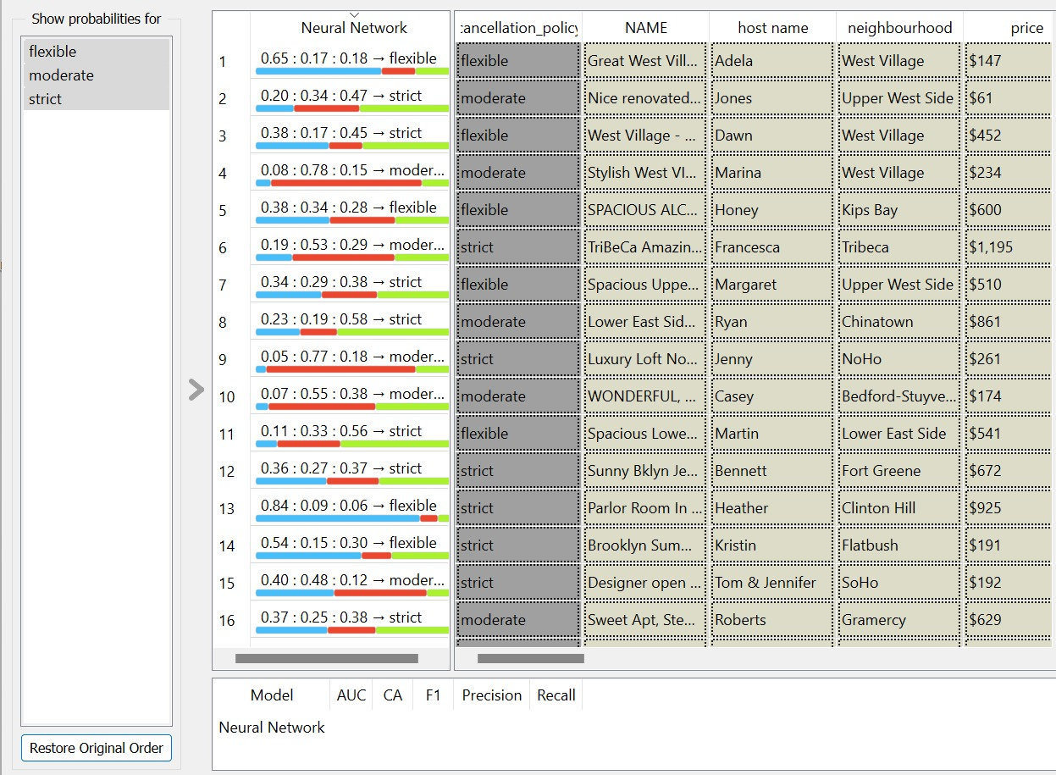
CSV DATA ANALYSIS
DATA MODELING
Predictions widget :

Slide 24
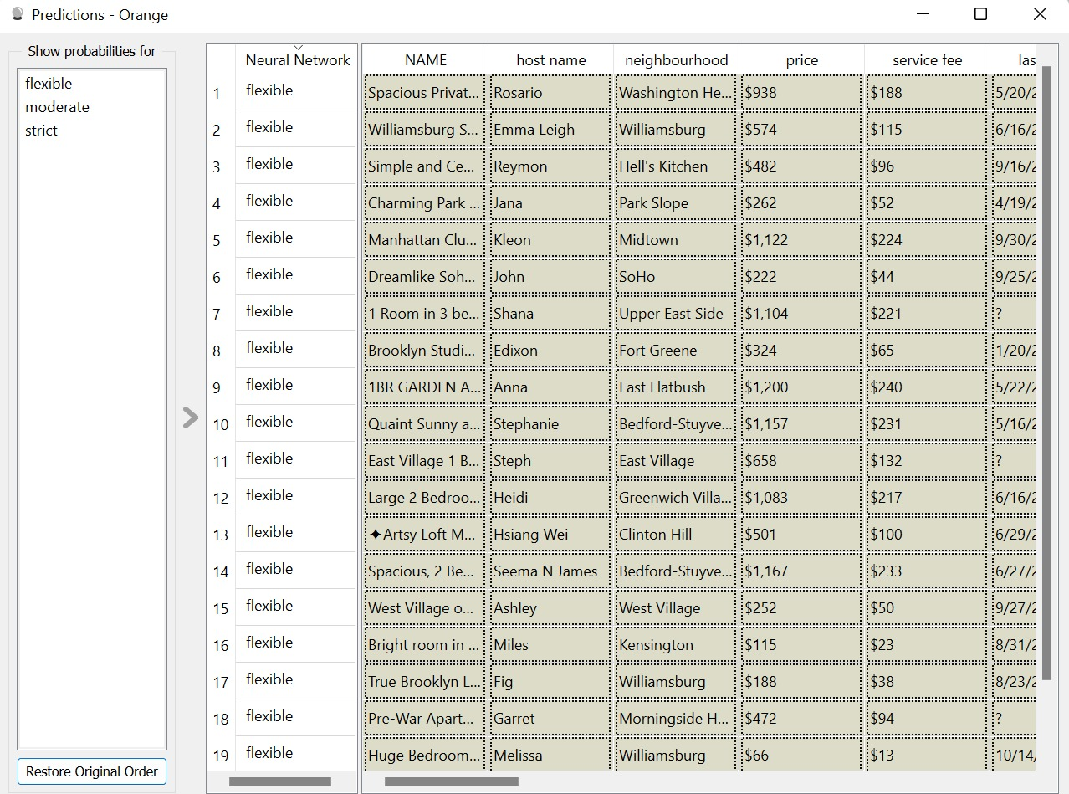
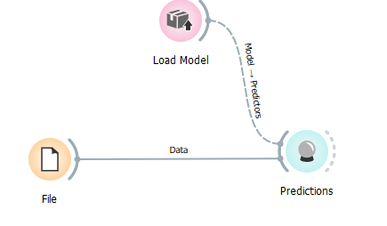
CSV DATA ANALYSIS
DATA PREDICTION

Slide 25
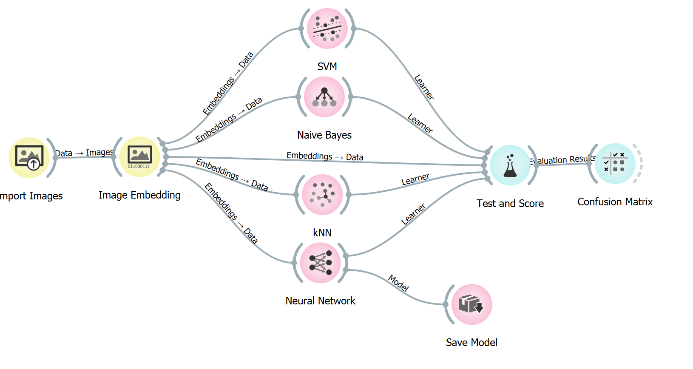
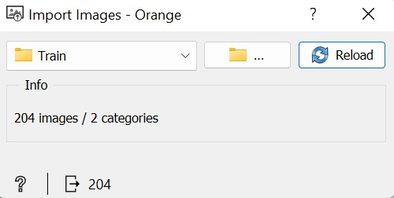
IMAGE PROCESSING
Image classification

Slide 26
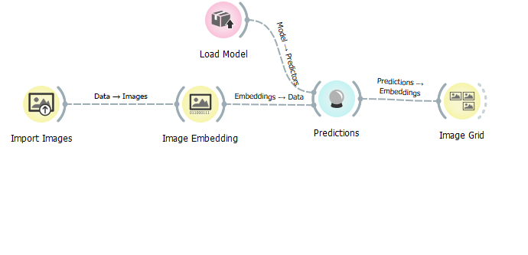
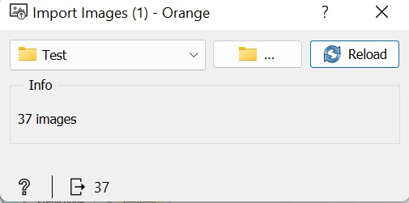
IMAGE PROCESSING
Image Prediction

Slide 27
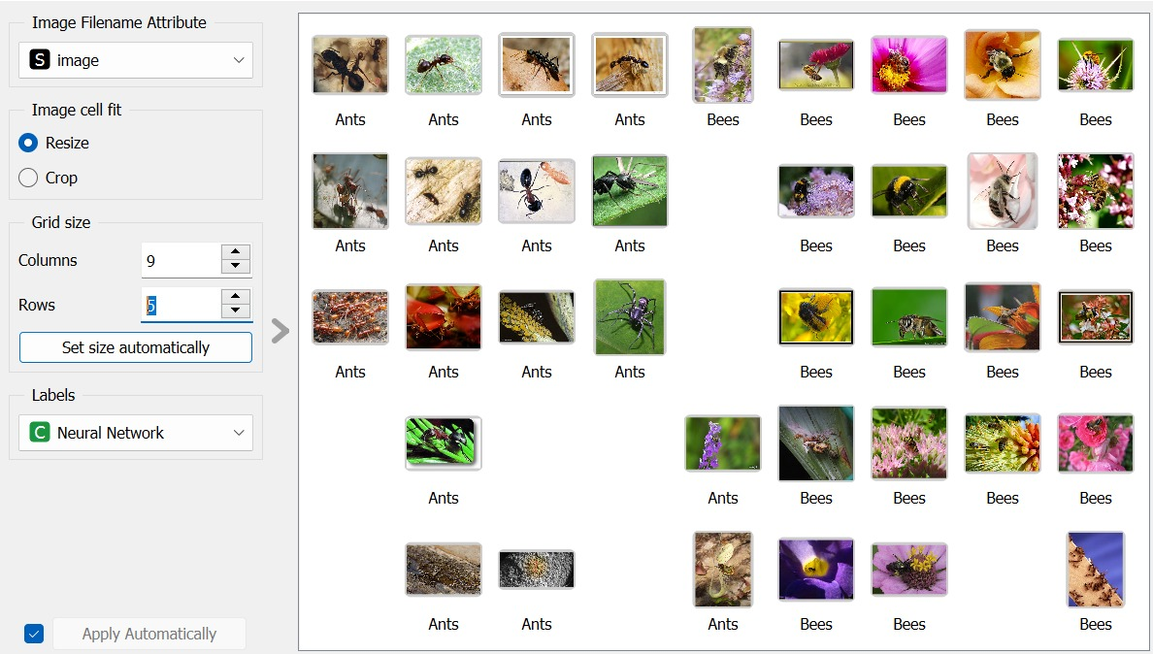
IMAGE PROCESSING
Image Prediction
IMAGE GRID WIDGET :

Slide 28

THANK YOU FOR YOUR ATTENTION

